Slide 1

Unlocking Healthcare Efficiency with Predictive Analytics: Montanaro Hospital's Patient Insight App
Robert Zell
Mario Alcaraz
Hamza Yousaf

Slide 2


Introduction
Dr. Erin Kelly, overseeing Montanaro Hospital's 23-bed Observation Unit (OU), noted extended patient stays and high "flip" rates from observation to inpatient status. With the OU operational for just over a year, Dr. Kelly aimed to reassess protocols and enhance patient placement rules.

Slide 3
Key Problems
Lengthy Average Stay
Average Misplaced patients per Week
Potential Loss in Revenue
Transition from Observation to Inpatient
100+
$1.33M
Suboptimal Use of the OU
Transition To Inpatient Status
Patients Surpassing Short-Term Intended Period
Lengthy Data Challenges and System Inefficiencies
45%
66%
Operational and Economic Impacts

Slide 4
Objectives
Maximize OU capacity, improve patient flow, and increase hospital revenue
Minimize patients leaving without being attended to
Provide staff with immediate access to predictive analytics
Refine OU operations for accurate and efficient patient triage
Build an app to provide insights for better management
Key Objectives

Slide 5






Methodology
Business Understanding
Data Understanding
Data Preparation
Modeling
Evaluation
Implementation
Independent Reading
Group Discussion
Expert Consultation
Distributions
Pivot Tables
Correlations
Missingness
PCA
Remove Missing Observations
Recoding Variables
Min-Max Normalization for Clustering
Classification of Flipping
Regression on Length of Stay
Clustering Analysis of Patient Characteristics
AUC & Accuracy for Classification Models
MAE & RMSE for Regression Techniques
Silhouette Scores for Clustering
Develop Predictive Analytics Application for Staff Use

Slide 6
Potential Benefits
Increased Hospital Capacity
More patients can be accommodated, improving the throughput.
How Will This Help?
Enhanced Patient Care
Quality of care can be augmented, reducing chances of medical errors due to unnecessary transfers.
The hospital can potentially realize significant financial gains, both from increased ED attendances and optimized resource allocation.
Economic Gains

Slide 7
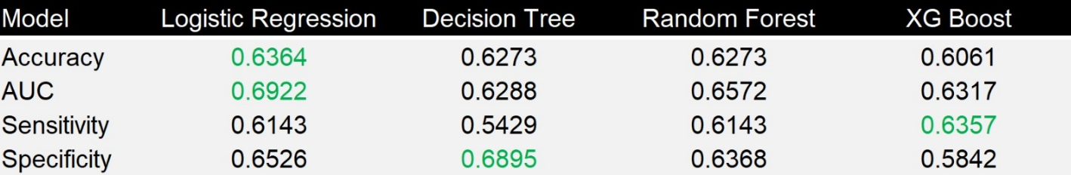
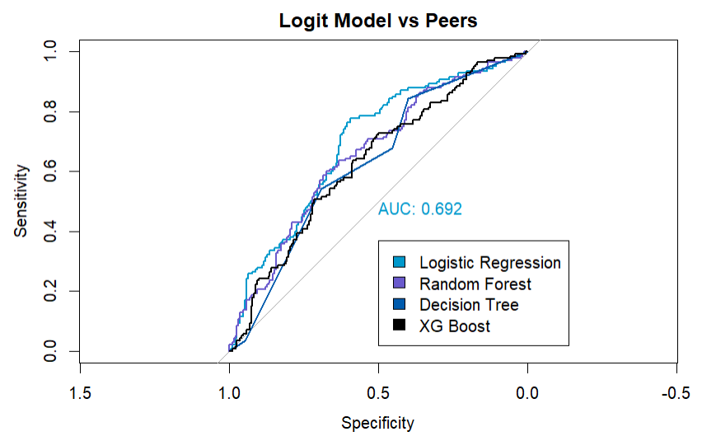
Results
Classification
Regression
Model Performance
Model Performance
ROC Curves

Slide 8
Results
Nested Modeling Approach
DRG Code
Pulse
Insurance Type
Flip
LOS
Age
Gender

Slide 9
App Demonstration

Slide 10
Recommendations
Immediate Integration of Logit & FGLS Models
1
Continuous Data Monitoring and Refinement
2
Improved Operations at Montanaro
Staff Training and Implementation
3
4
Feedback Mechanism
5
Human Oversight & Decision-making
4
Feedback Mechanism.

Slide 11
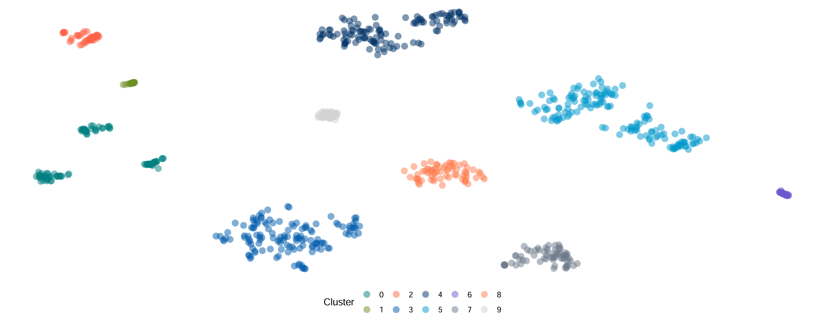
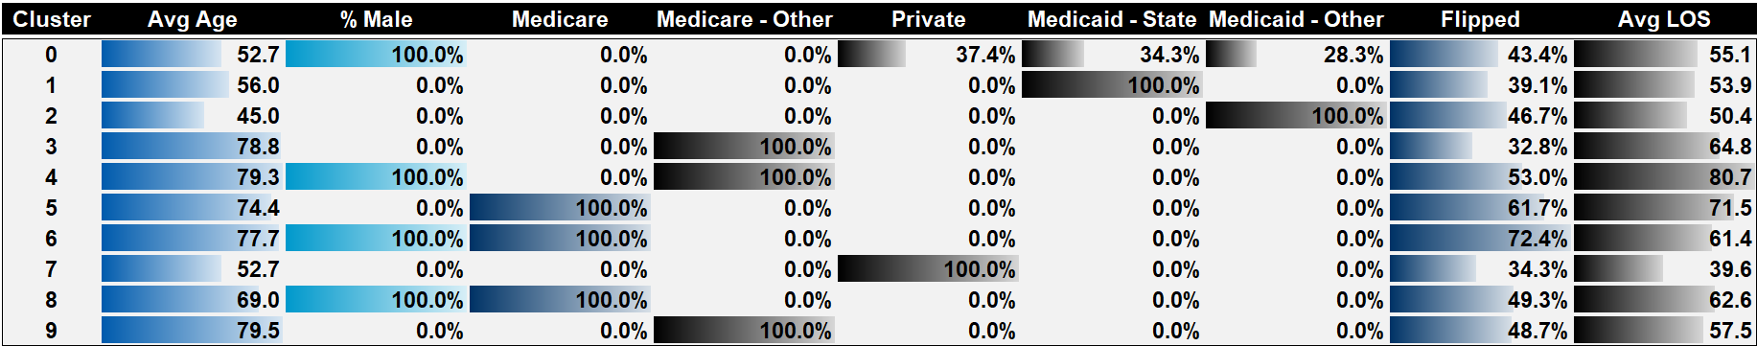
Further Opportunities: Clustering Analysis

Slide 12

Questions

Slide 13
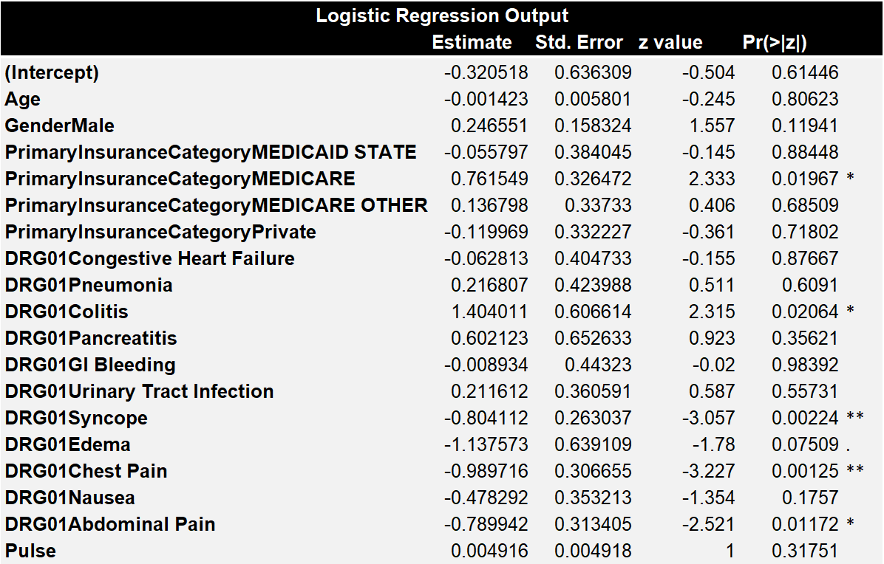
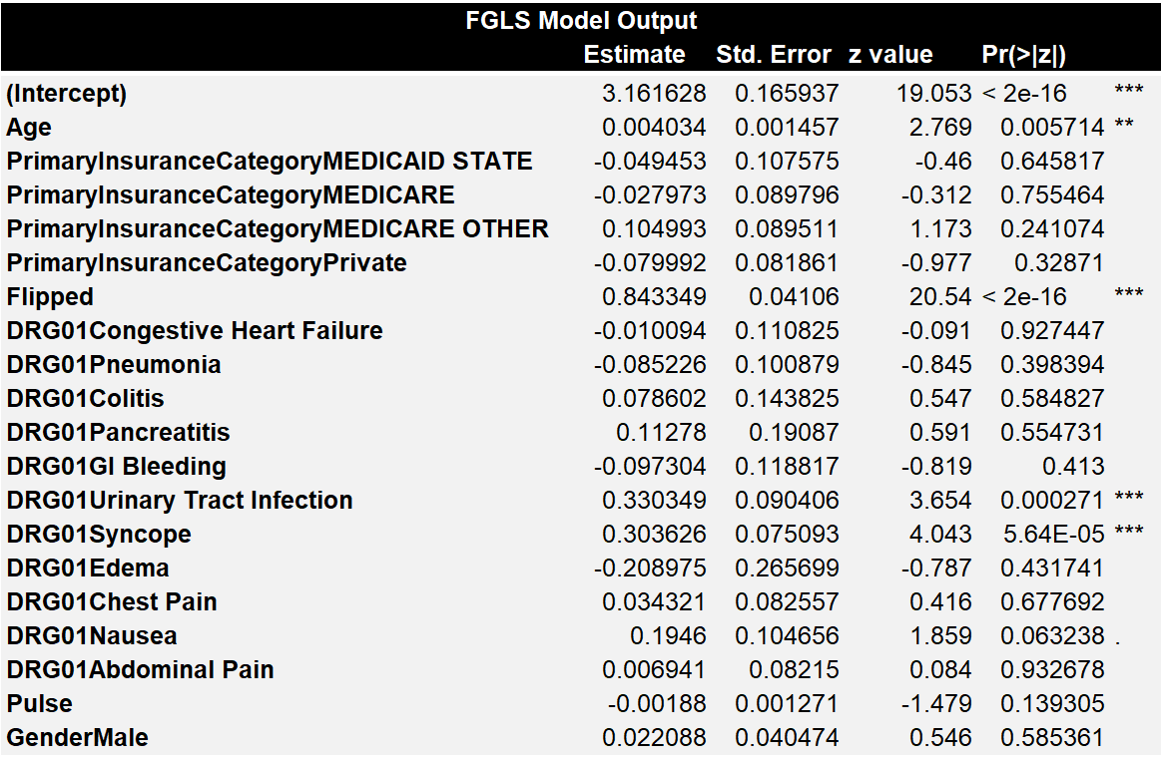
Appendix: Logistic and FGLS Model Output
Logistic Model Output
FGLS Model Output

